Slide 1
IBM University Engagement Project Submission
“Building ResQAI – An Agentic AI Disaster Response & Rescue Coordination Platform with IBM Granite and IBM BoB”

Slide 2

Project Title – ResQAI: AI-Powered Disaster Response & Rescue Coordination Platform
Domain of Project – Disaster Management
Student Name | Recent Passport Photo | Email ID | Mobile number [WhatsApp]
Gayatri Botcha |  | gayatri.008b@gmail.com | 9346945405
Recommended font style and size: Font Style: Arial Font Size (Heading): 28
Font Size (Content): 20

Slide 3
Problem Statement -
Problem Statement : ResQAI – Disaster Response & Rescue Coordination Platform
The Challenge
Natural disasters such as floods, earthquakes, cyclones, and fires make it difficult for people to access timely emergency information, locate safe shelters, and request rescue support. The lack of a centralized, AI-powered platform delays response and increases risks to lives and property.
The Objective
Build an AI-powered Disaster Response & Rescue Coordination Platform that provides real-time emergency assistance and intelligent disaster guidance. The solution should include:
AI Emergency Assistant – Instant disaster guidance and safety instructions.
Disaster Information Retrieval – Reliable disaster alerts and first-aid guidance.
SOS & Incident Reporting – Report emergencies and request rescue support.
Shelter Recommendation – Locate nearby shelters, hospitals, and relief centers.
Preparedness & Dashboard – Emergency checklists, alerts, and real-time disaster insights.

Slide 4
Proposed Solution -
Proposed Solution: ResQAI – AI-Powered Disaster Response & Rescue Coordination Platform
The proposed solution is an AI-powered Disaster Response & Rescue Coordination Platform built using IBM BoB, IBM watsonx.ai, Granite Models, Flask, HTML, CSS, and JavaScript. It provides real-time disaster guidance, emergency assistance, and rescue coordination through an intelligent multi-agent system.
Key Agents:
Disaster Knowledge Agent – Provides verified disaster information and safety guidelines.
Emergency Assistance Agent – Delivers AI-powered emergency guidance and first-aid support.
Rescue Coordination Agent – Handles SOS requests and incident reporting.
Shelter & Resource Agent – Recommends nearby shelters, hospitals, and relief centers.
The platform features a responsive web dashboard for AI assistance, incident reporting, emergency checklists, and real-time disaster support.
IBM BoB accelerates application development, while IBM watsonx.ai Granite Models power intelligent reasoning and personalized emergency responses.
Overall, ResQAI enables faster emergency response, improved public safety, and efficient disaster management.

Slide 5
Technology Used
IBM BoB – For AI-assisted application development, code generation, debugging, and project acceleration.
IBM Granite Model (e.g., granite-3-2-8b) – For natural language understanding, reasoning, emergency guidance, and personalized AI assistance.
IBM Cloud – Provides a secure, scalable, and reliable platform for deploying and managing the ResQAI application and AI services.
RAG (Retrieval-Augmented Generation) – Retrieves trusted disaster information, emergency guidelines, and safety protocols before generating accurate AI responses.
IBM Watsonx.ai – For AI model deployment, prompt engineering, inference, and governance of the Granite foundation model.
Vector Database (FAISS/Chroma) – Stores disaster knowledge embeddings for fast and accurate RAG-based retrieval of emergency information.
Flask – Backend framework for integrating AI services, managing routes, and handling user requests.
HTML, CSS & JavaScript – Used to build a responsive and user-friendly web interface for disaster response and rescue coordination.

Slide 6
Key Application Components Used -
1) Web Dashboard (UI) – Built with HTML, CSS & JavaScript; lets users view alerts, report emergencies, and access disaster guidance.
2) IBM watsonx.ai Granite Model – Processes user queries and generates real-time emergency guidance and personalized responses.
3) Flask Backend – Manages API routes, request handling, and integration between the UI and AI services.
4) RAG + Vector Database (FAISS/Chroma) – Retrieves verified disaster knowledge before generating AI responses.
5) SOS & Incident Reporting Module - Captures emergency reports and routes them to the Rescue Coordination Agent.
6) IBM BoB – Assists in accelerated application development, code generation, and debugging.

Slide 7
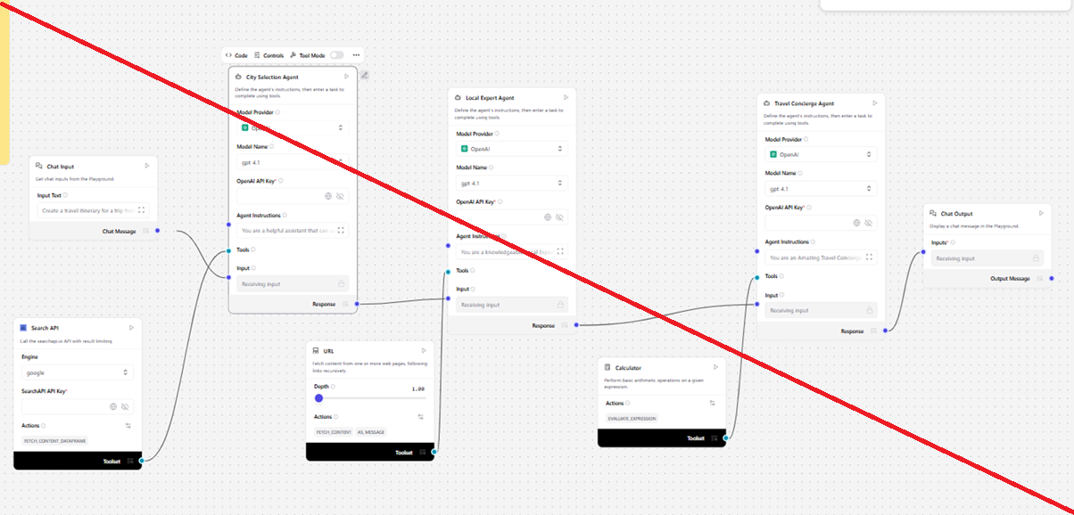
Application Workflow -

Slide 8
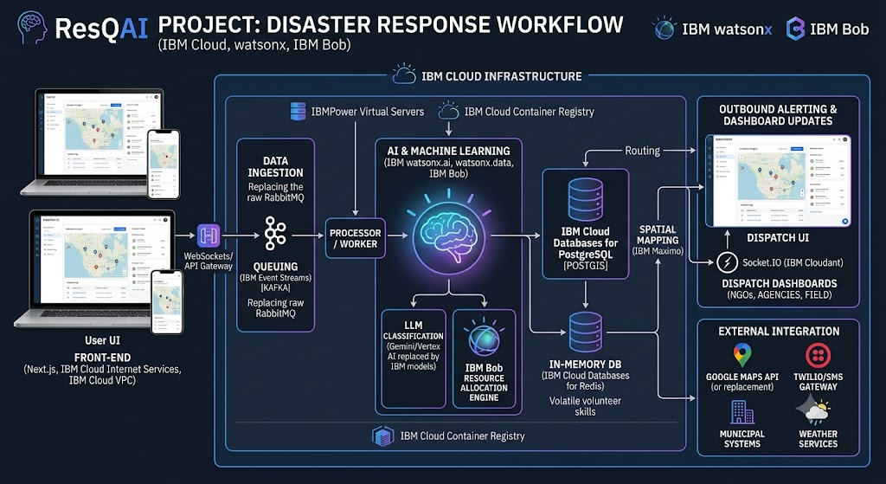
Architecture blueprint

Slide 9

Role of Agentic AI in the solution
Role of Agentic AI in ResQAI
Agentic AI enables ResQAI to function as an intelligent disaster response system rather than a simple chatbot. Using IBM watsonx.ai and IBM Granite Models, it coordinates multiple AI agents to provide real-time emergency assistance.
Each agent performs a specific task—retrieving disaster information, providing emergency guidance, managing SOS requests, and recommending nearby shelters—while working together for faster and more accurate disaster response.
Agentic AI understands the user's situation and adapts its recommendations based on the disaster type, location, and emergency conditions. It also enables collaboration between agents, ensuring efficient rescue coordination and informed decision-making.
Overall, Agentic AI makes ResQAI proactive, context-aware, and intelligent, helping save lives through faster emergency response and disaster management.

Slide 10


Token Usage
11,761 token are used
Before Prompt
After the Prompt
·
·
·

Slide 11
Novelty and Uniqueness
The proposed ResQAI stands out by combining Agentic AI, RAG, and IBM BoB-accelerated development into a single intelligent disaster-response system.
Multi-Agent Coordination – Instead of a single chatbot, four specialized agents collaborate to deliver accurate, context-aware disaster response.
RAG-Based Reliability – Combines real-time data retrieval with AI generation, reducing misinformation during emergencies.
Rapid Development with IBM BoB – Accelerates building, testing, and deployment of the platform.
Real-Time SOS & Rescue Coordination – Enables instant incident reporting and coordinated rescue response.
Location-Aware Shelter Recommendations – Helps users quickly find nearby shelters, hospitals, and relief centers.
Preventive & Proactive Guidance – Provides safety instructions and preparedness checklists before disasters escalate.
Scalable & Enterprise-Ready – Built on IBM watsonx.ai with IBM Granite models, ensuring reliability and governance.
This makes the solution a smart, adaptive, and proactive digital disaster response assistant, not just a static alert system.

Slide 12
Git Hub Link
· Please create public github repository (Enable Add README button while creating repository) with format –
Please test and Paste the working Github URL –https://github.com/Gayatri-user/ResQAI_IBM-project
Make sure you have Uploaded following three files into your github repository 1) app.json file , 2) yourproblemstatement.pdf file 3) your projectpresntation.pptx file 4)any other files
·
·
·

Slide 13
Future Scope
1. Real-Time Disaster Alerts & IoT Integration
The system can be integrated with weather APIs, IoT sensors, and satellite data to provide real-time disaster alerts, early warnings, and live environmental monitoring. This will help citizens receive timely notifications and improve disaster preparedness.
2. AI Voice Assistant & Multilingual Support
Enhancing ResQAI with an AI-powered voice assistant and multilingual support will enable users to report emergencies and receive disaster guidance in their preferred language. This will improve accessibility, especially during emergencies and in rural or linguistically diverse regions.
·
·
·

Slide 14
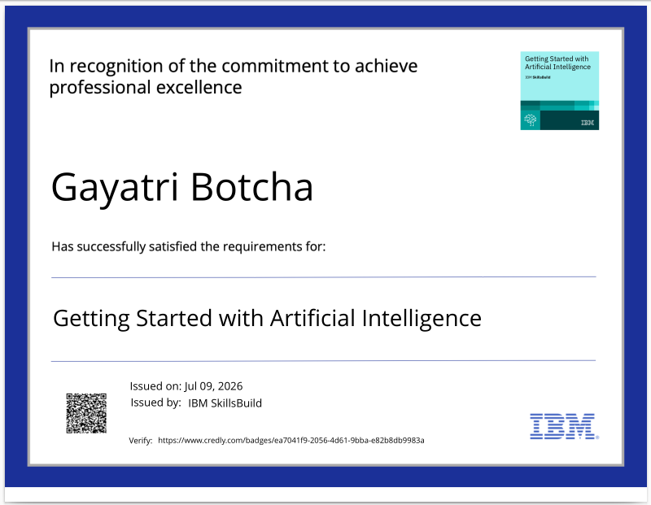
Certificates Earned:
Please add your credly certificate

Slide 15
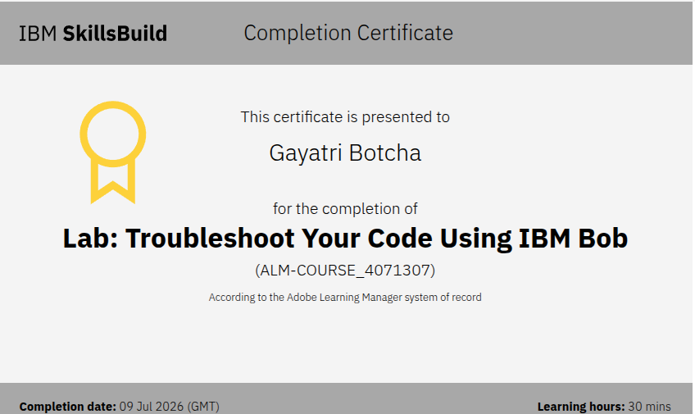
Certificates Earned:​
Add your IBM BOB Certificate

Slide 16


